Slide 1


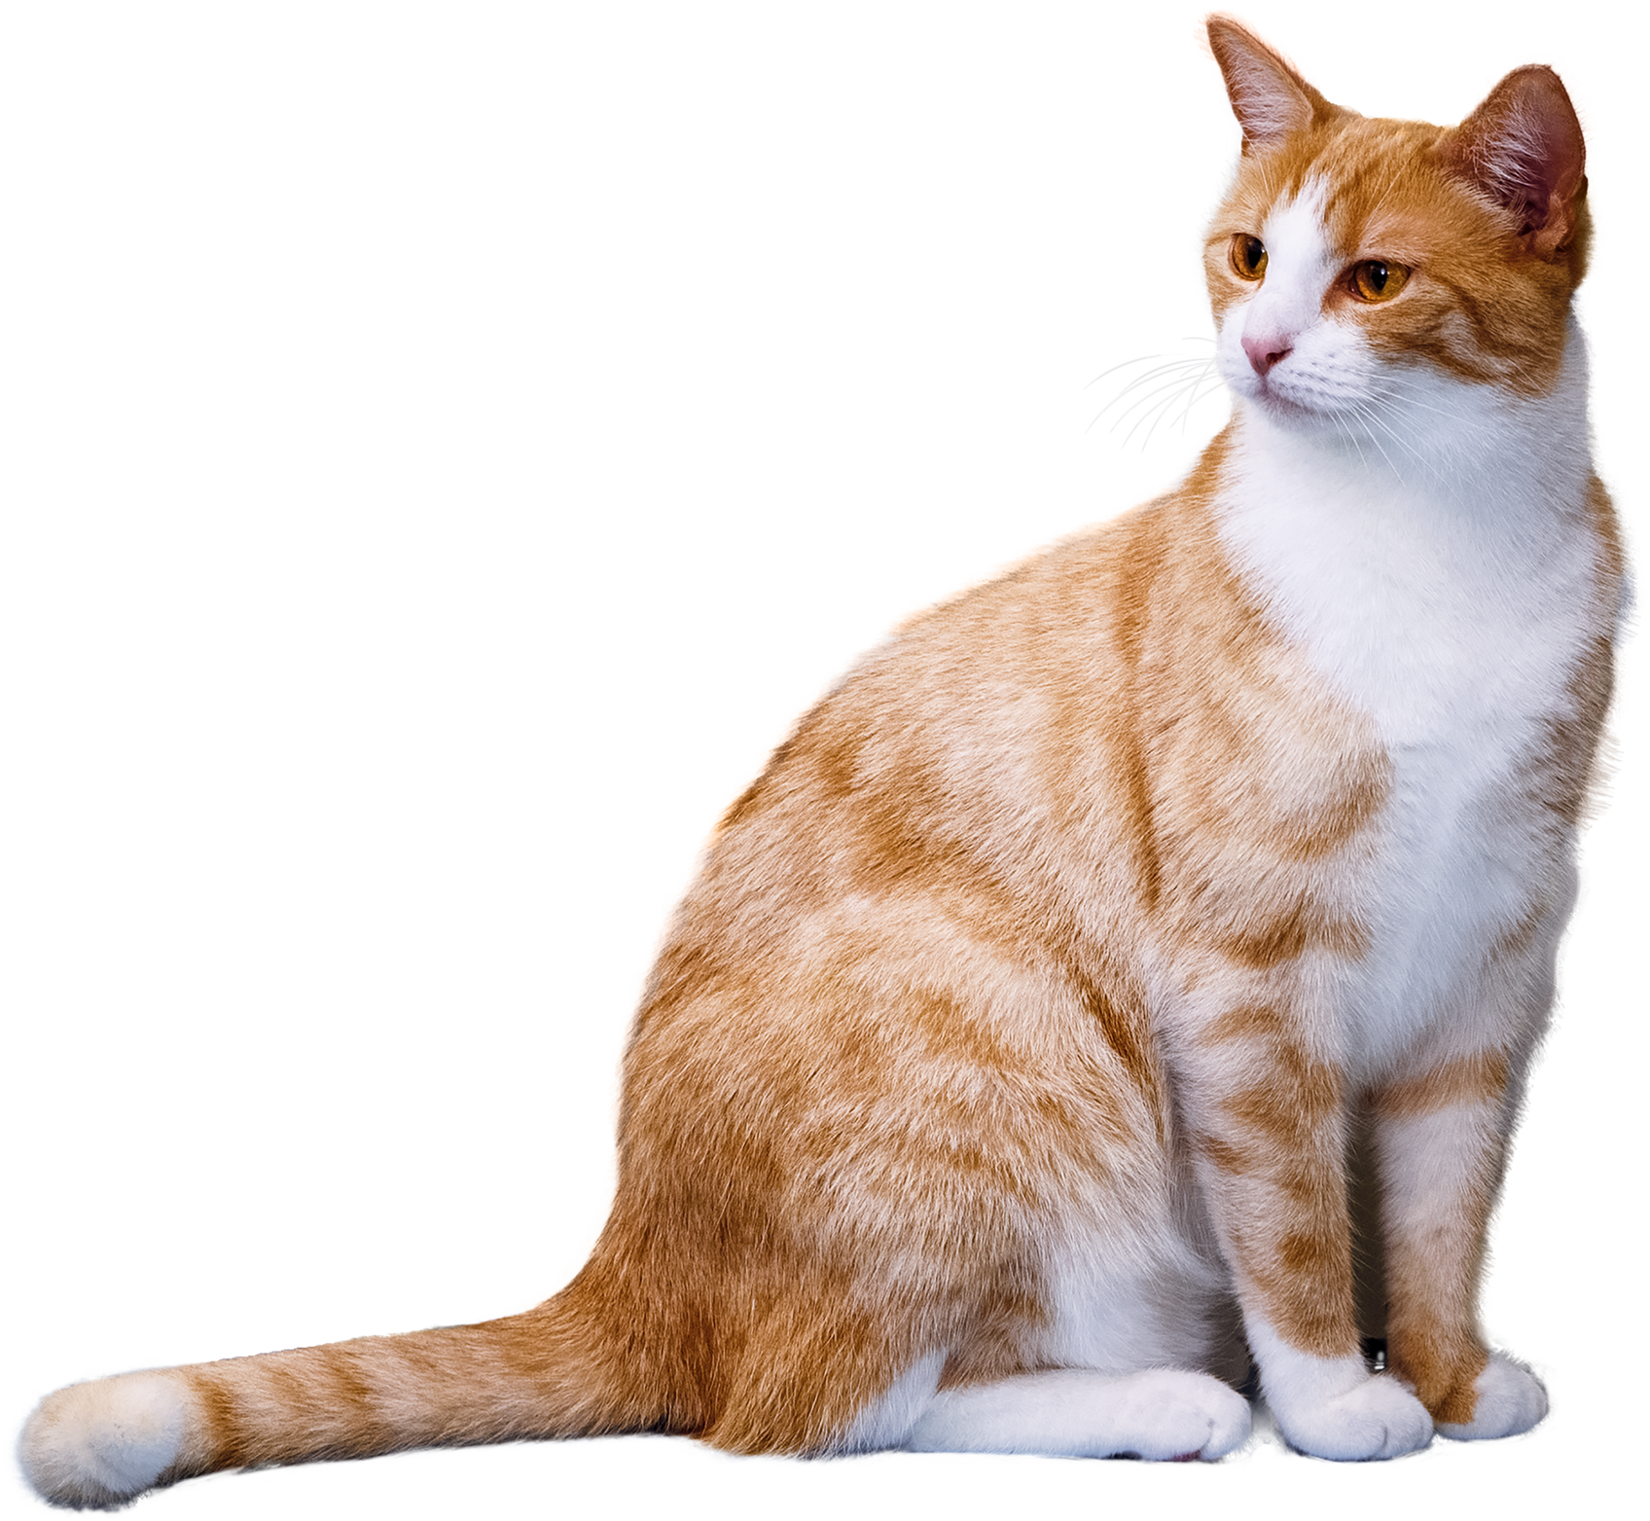


WATERMARK REMOVAL AND INPAINTING
Presentation by:
Lily Ren, Tina Shen, Xinyue Zhang
May 8, 2024
EN.553.493/693 Mathematical Image Analysis
Johns Hopkins University

Slide 2


Table of
Contents
Page
I
Background & Motivation
3
II
Mathematical Modeling
6
III
Implementations
23
IV
Results
34
V
Conclusion & Discussions
40

Slide 3

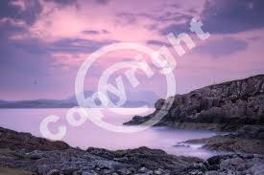
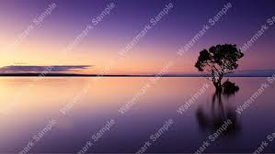
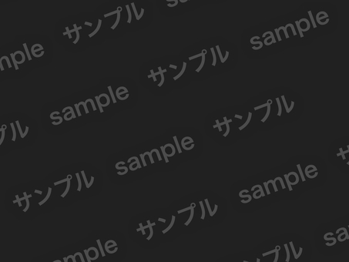
BACKGROUND
https://lenscraft.co.uk/photo-editing-tutorials/tutorial-add-watermark-in-photoshop/
https://lenscraft.co.uk/photo-editing-tutorials/tutorial-add-watermark-in-photoshop/
https://thinkmobiles.com/posts/1382/
https://en.ac-illust.com/clip-art/22209347/-quot-sample--amp--sample-quot--watermark-b--black
EN.553.493/693 Mathematical Image Analysis
Background & Motivation

Slide 4
MOTIVATION
The swift evolution of Internet technology enables extensive information sharing, with images playing a vital role. Visible watermark technology is commonly used for online image copyright protection. However, this method can be intrusive and detract from the viewing experience.
To address this, we propose a mathematical-based framework for the detection and removal of visible watermarks in images, consisting of two main components.
EN.553.493/693 Mathematical Image Analysis
Background & Motivation

Slide 5

METHOD
DETECTION
INPAINT
Apply gradient descend to identify watermarks by analyzing patterns and inconsistencies in images.
Hypothesis: Consistent application (Watermarks added in a consistent way)
Employ inpainting techniques to remove the watermark, restoring the image to its near-original state. We implement two:
-1 TV Regularization
-2 Mumford-Shah
EN.553.493/693 Mathematical Image Analysis
Background & Motivation

Slide 6
Table of
Contents
Page
I
Background & Motivation
3
II
Mathematical Modeling
6
III
Implementations
23
IV
Results
34
V
Conclusion & Discussions
40

Slide 7
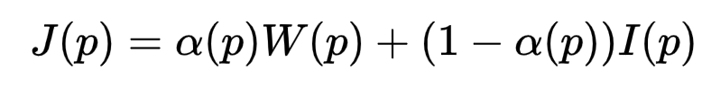
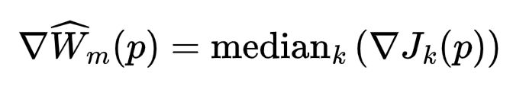

DETECTION
J: Watermark Image, I: natural image
p = (x,y): the pixel location
alpha(p): alpha matte
Estimate the watermark
Crop the watermark to remove boundary regions
Detect the watermark (using the Canny edge detector and chamfer matching.)
Reconstruct the watermark by Poisson reconstruction
EN.553.493/693 Mathematical Image Analysis
Mathematical Modeling

Slide 8
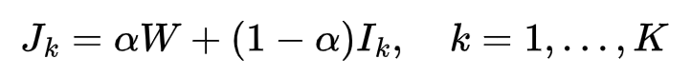
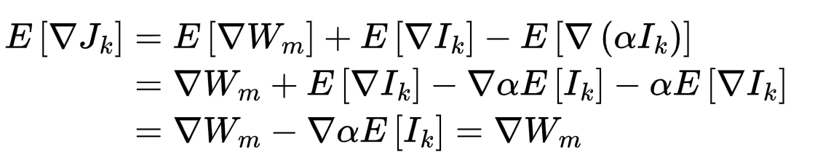
DETECTION
Estimate the watermark
Estimate the watermark
EN.553.493/693 Mathematical Image Analysis
Mathematical Modeling

Slide 9
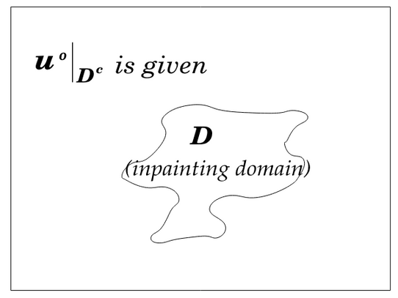
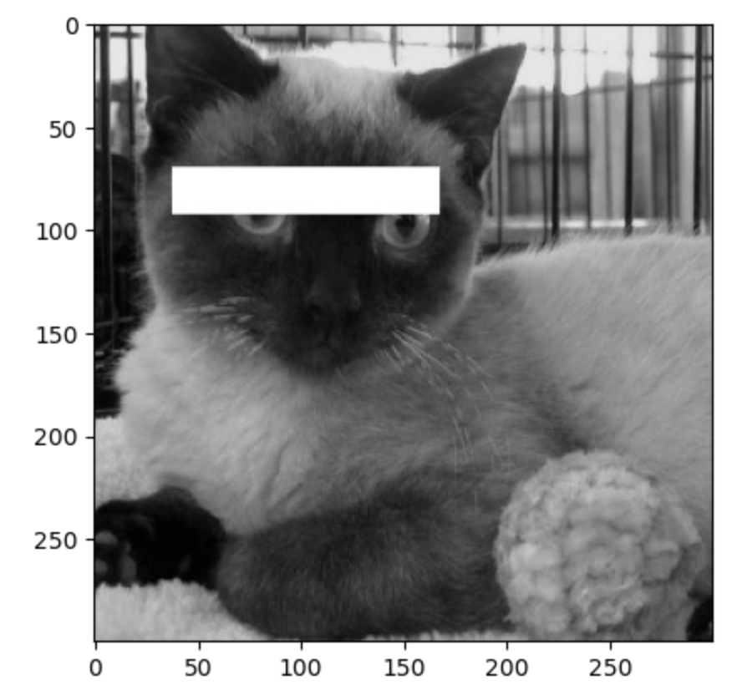
PROBLEM
u0 is often noisy original image,
Assumption: u0 = u_true + Gaussian noise n
Ω: Image domain, D: the inpainting domain
Tichonoff? Wiener? Total Variation?
Something more?
D
EN.553.493/693 Mathematical Image Analysis
Mathematical Modeling
Notes:
just represent length when gamma is regular.

Slide 10
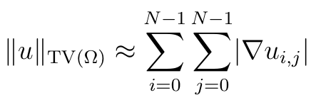
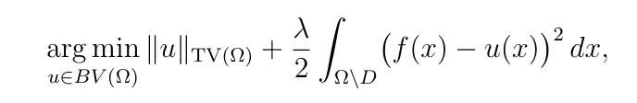
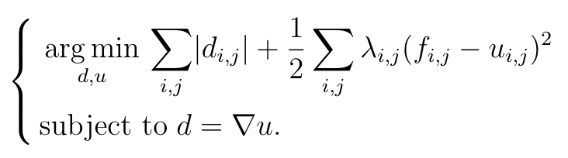
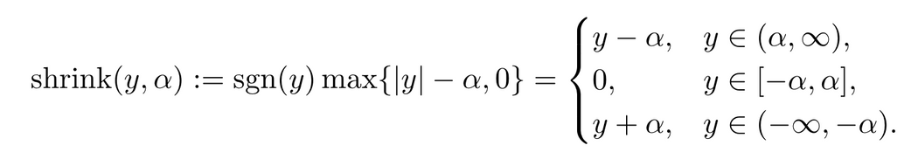
SPLIT BREGMAN
Discrete form
Total Variation Regularization to be minimized
rewritten in Bregman form
shrinkage operator
P. Getreuer, “Total Variation Inpainting using Split Bregman,” Image Processing On Line, 2012. DOI: 10.5201/ipol.2012.g-tvi.
EN.553.493/693 Mathematical Image Analysis
Mathematical Modeling

Slide 11
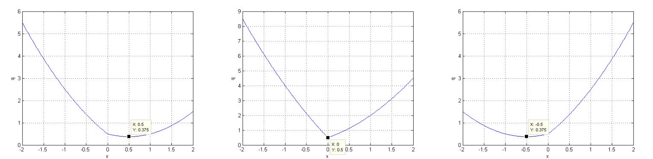
SPLIT BREGMAN
shrinkage operator
y ≥ µα
- µα < y < µα
credit: Bin Hu, Nonsmooth Convex Optimization, 2018
y ≤ µα
EN.553.493/693 Mathematical Image Analysis
Mathematical Modeling

Slide 12
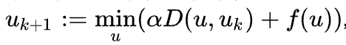
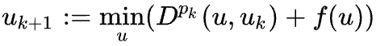
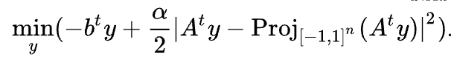
SPLIT BREGMAN
Bregman iteration method
using dual to compute -- faster
<-- where the b is from!
Bregman L. "A Relaxation Method of Finding a Common Point of Convex Sets and its Application to Problems of Optimization". Dokl. Akad. Nauk SSSR, v. 171, No. 5, 1966, p.p. 1019-1022.
EN.553.493/693 Mathematical Image Analysis
Mathematical Modeling

Slide 13
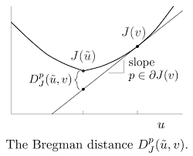
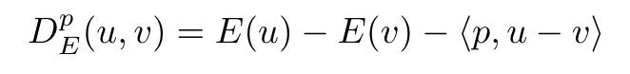
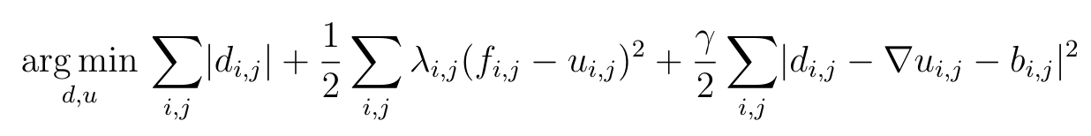
SPLIT BREGMAN
Bregman Distance
using Bregman iteration method
P. Getreuer, “Total Variation Inpainting using Split Bregman,” Image Processing On Line, 2012. DOI: 10.5201/ipol.2012.g-tvi.
EN.553.493/693 Mathematical Image Analysis
Mathematical Modeling

Slide 14
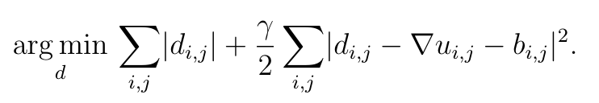
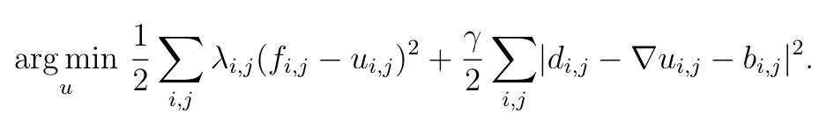
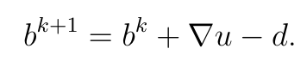
SPLIT BREGMAN
EN.553.493/693 Mathematical Image Analysis
Mathematical Modeling

Slide 15
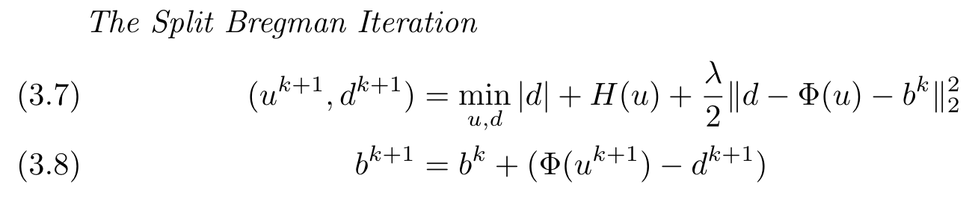
SPLIT BREGMAN
EN.553.493/693 Mathematical Image Analysis
Mathematical Modeling

Slide 16
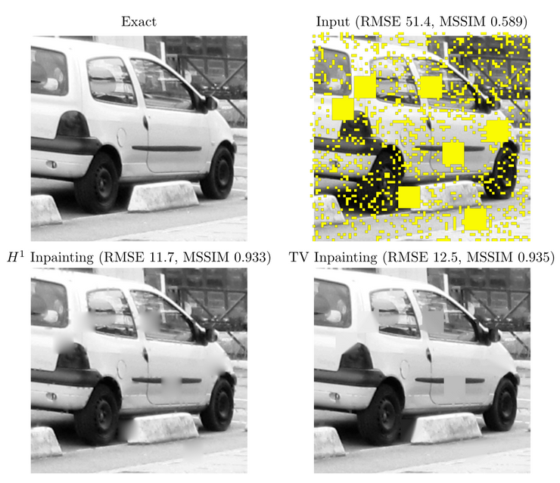
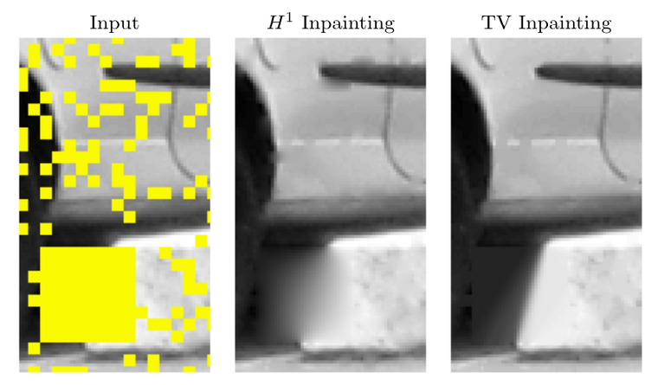
SPLIT BREGMAN
P. Getreuer, “Total Variation Inpainting using Split Bregman,” Image Processing On Line, 2012. DOI: 10.5201/ipol.2012.g-tvi.
EN.553.493/693 Mathematical Image Analysis
Mathematical Modeling

Slide 17
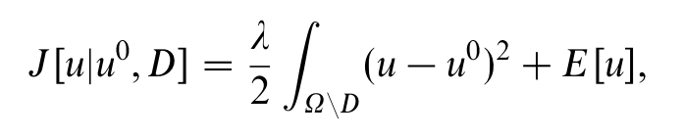
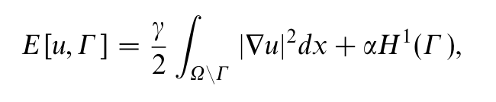
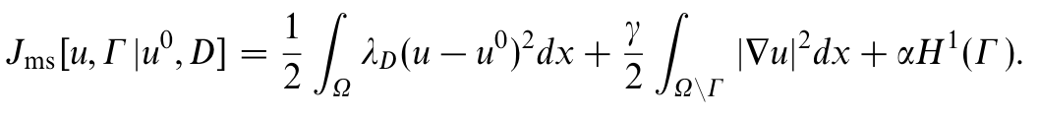
MUMFORD-SHAH
Approximate image u by a piecewise smooth function u^0 as the solution to the variational problem
H is one-dimensional Hausdorff measure of Γ, or simply length
ENERGY FUNCTION
object-edge model
Find a pair (u, Γ) minimising:
data fedelity
disc. at adges
smooth
EN.553.493/693 Mathematical Image Analysis
Mathematical Modeling
Notes:
enforces fidelity to the original image, particularly in the damaged areas D, where lambda_D is large.
promotes smoothness in the reconstructed image by penalizing large gradients.
third term penalizes the complexity of the discontinuity set, encouraging solutions with fewer and simpler edges.

Slide 18
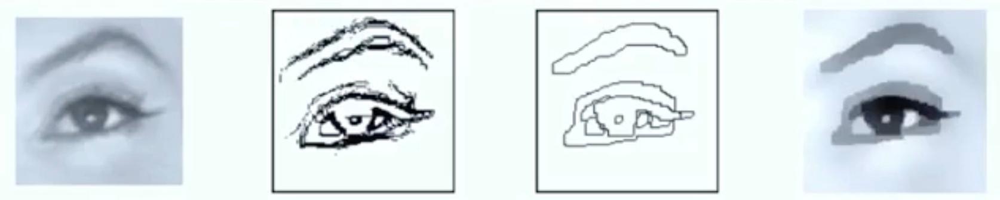

MUMFORD-SHAH
EXAMPLE
all edges
smooth,
disc. at edges
data fedelity
data fedelity
disc. at edges
smooth
Difficult to solve because we are dealing with respect to both u and Γ & presence of the discontinuity set Γ
EN.553.493/693 Mathematical Image Analysis
Mathematical Modeling
Notes:
approximate the image with less colors. Panelty of deviate too much from the original image. E.g. All white image is very smooth but will be panellised by this term. MSE!! We want the piecewise-smooth version of the image but not to far from the image.

Slide 19
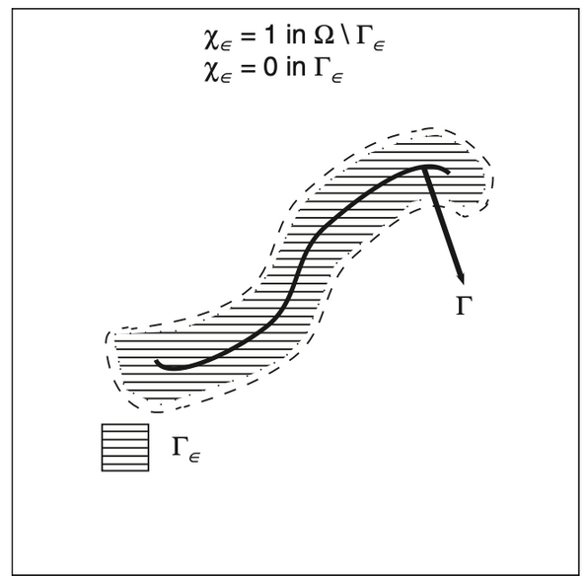
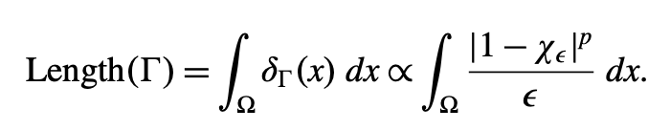
AMBROSIO-TORTORELLI APPROXIMATION
approximate H(Γ) using a continuous indicator function 𝜒.
χ is close to 0 around edge Γ, otherwise 1
SIMPLIFY
ϵ is a parameter controlling the width of the transition between 0 - 1
Source: PDE Methods for Inpaintings, Carola-Bibiance Inpainting
EN.553.493/693 Mathematical Image Analysis
Mathematical Modeling

Slide 20
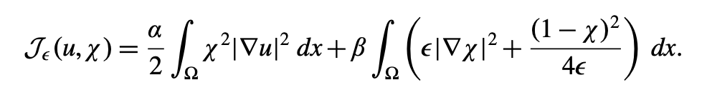
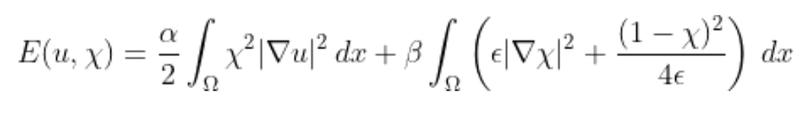
AMBROSIO-TORTORELLI APPROXIMATION
χ_ε is computed, for a given image u, as the minimiser of
FORMULA
Now, the problem transforms into
Which is the formula used in the implementation.
EN.553.493/693 Mathematical Image Analysis
Mathematical Modeling

Slide 21
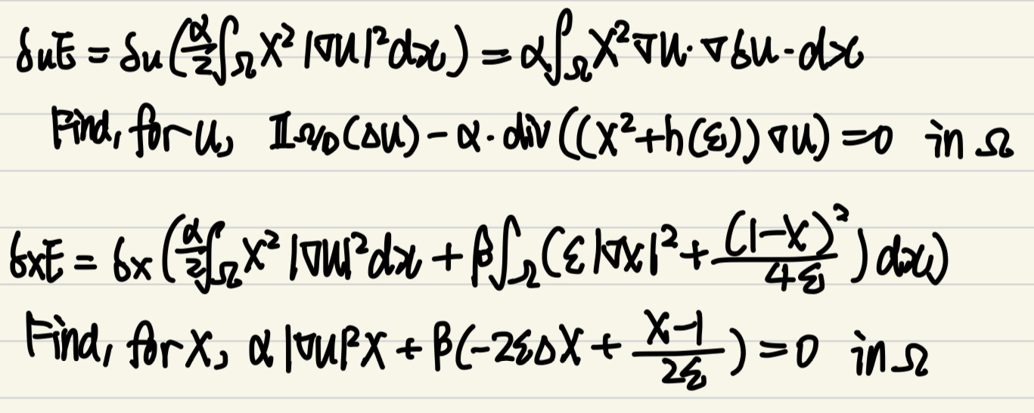
AMBROSIO-TORTORELLI APPROXIMATION
Find Euler-Lagrange Equations,
The variation of E with respect to 𝜒 and u:
FORMULA
EN.553.493/693 Mathematical Image Analysis
Mathematical Modeling

Slide 22
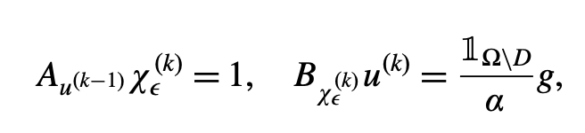
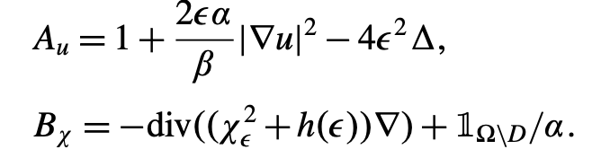
AMBROSIO-TORTORELLI APPROXIMATION
One way of solving this non-linear system of equations is to approximate it iteratively by a sequence of linear equations as follows:
FORMULA
And so
is used in the iterative implementation
EN.553.493/693 Mathematical Image Analysis
Mathematical Modeling

Slide 23
Table of
Contents
Page
I
Background & Motivation
3
II
Mathematical Modeling
6
III
Implementations
23
IV
Results
34
V
Conclusion & Discussions
40

Slide 24
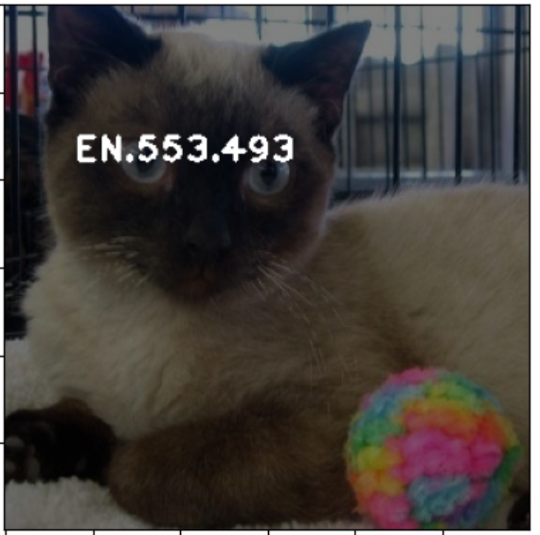
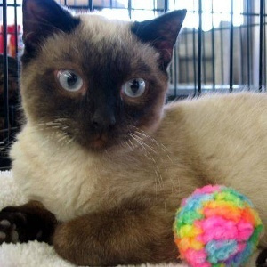
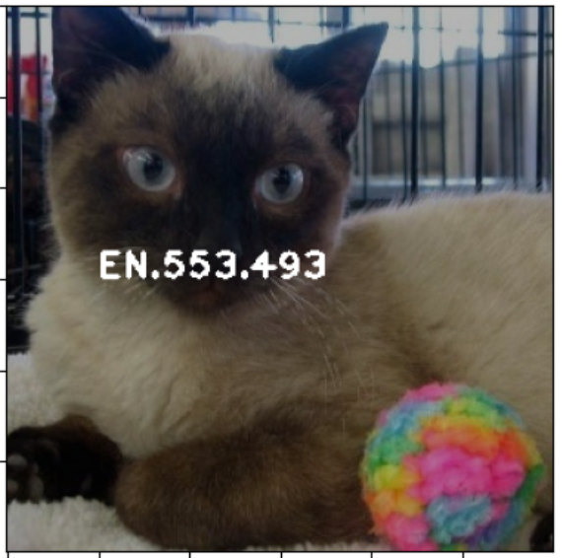
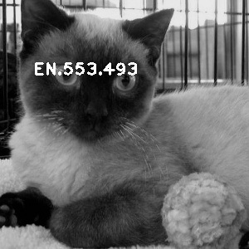
ADD WATERMARK
Dataset is the first 50 cat images from Kaggle's Cat vs. Rabbit dataset. We have a soft spot for cats.
EN.553.493/693 Mathematical Image Analysis
Implementations

Slide 25
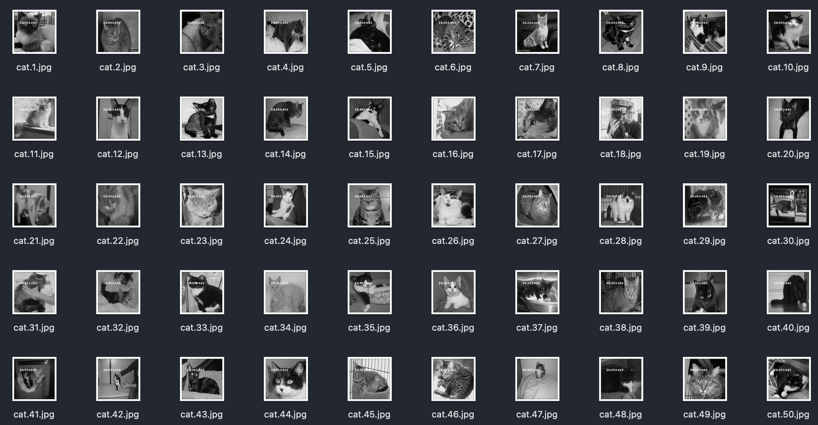
ADD WATERMARK
we have iterations afterall
EN.553.493/693 Mathematical Image Analysis
Implementations

Slide 26
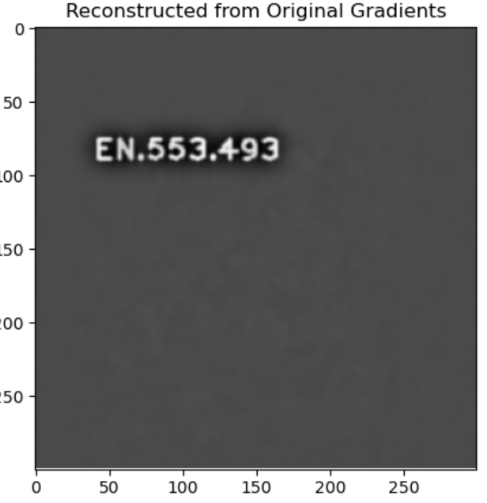
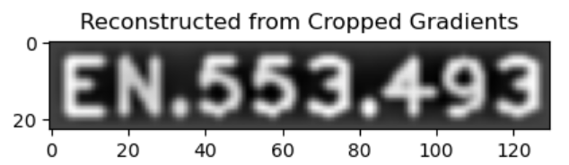
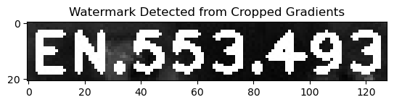
DETECTION
EN.553.493/693 Mathematical Image Analysis
Implementations

Slide 27
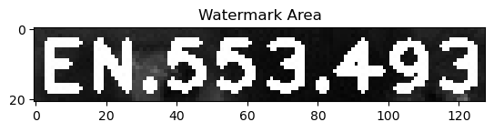
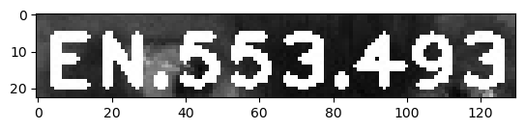
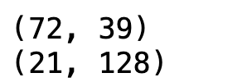
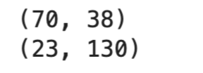
DETECTION
EN.553.493/693 Mathematical Image Analysis
Implementations

Slide 28

DETECTION
EN.553.493/693 Mathematical Image Analysis
Implementations

Slide 29
PROBLEM
Ω: Image domain,
D: the inpainting domain
Mask: D area in black
D
EN.553.493/693 Mathematical Image Analysis
Implementations

Slide 30
IMPLEMENTATION
Differential Operators: Bregman distance D(u^k), Forward formula (row difference and column difference)
Gradient: image gradient (Dfi, Dfj for forward differences; Dbi, Dbj for backward differences)
Laplacian: Laplacian matrix (L)
Sobel
Use default library
EN.553.493/693 Mathematical Image Analysis
Implementations

Slide 31

PSEUDO CODE
For i=1 to max iterations do:
Compute A Matrix, encouraging 𝜒 to be 0 in edges, integrating the squared gradient of 𝑢 & regularization terms. Better segment the regions
Update 𝜒:
Solve A𝜒=rhsM for 𝜒 using sparse linear solver,
Compute B Matrix.
Update 𝑢:
Solve B𝑢=rhsL using sparse linear solver. Improve fidelity to the original image data and smoothing within the areas delineated by 𝜒
Check Convergence
EN.553.493/693 Mathematical Image Analysis
Implementations

Slide 32
IMPLEMENTATION
gradient, laplacian
buildMatrix_A
buildMatrix_B
iterative solver
Hyperparameter: max iteration, fielity, alpha, tolerance, gamma, epsilon
Disadvantage: cannot choose ε as small as would be required for obtaining a highly resolved approximation to the edge set .
Esedoglu and Shen: for numerical stability of the transition layer of χ, the parameter ε even has to be a multiple of grid size x. For inpainting though, recover the image u not the edge set χ
EN.553.493/693 Mathematical Image Analysis
Implementations

Slide 33

IMPLEMENTATION
Split Bregman method
updating d, u, and b in each iteration -- solve the problems and overwrite the masked image
EN.553.493/693 Mathematical Image Analysis
Implementations

Slide 34
Table of
Contents
Page
I
Background & Motivation
3
II
Mathematical Modeling
6
III
Implementations
23
IV
Results
34
V
Conclusion & Discussions
40

Slide 35

MUMFORD-SHAH
EN.553.493/693 Mathematical Image Analysis
Results

Slide 36

TEXUAL WATERMARK
EN.553.493/693 Mathematical Image Analysis
Results

Slide 37


MUMFORD-SHAH
EN.553.493/693 Mathematical Image Analysis
Results

Slide 38


MUMFORD-SHAH
EN.553.493/693 Mathematical Image Analysis
Results

Slide 39



SPLIT BREGMAN
EN.553.493/693 Mathematical Image Analysis
Results

Slide 40
Table of
Contents
Page
I
Background & Motivation
3
II
Mathematical Modeling
6
III
Implementations
23
IV
Results
34
V
Conclusion & Discussions
40

Slide 41

PYTHON
EN.553.493/693 Mathematical Image Analysis
Conclusion & Discussions

Slide 42

PYTHON
EN.553.493/693 Mathematical Image Analysis
Conclusion & Discussions

Slide 43

AUTOENCODER
EN.553.493/693 Mathematical Image Analysis
Conclusion & Discussions

Slide 44

UNET
EN.553.493/693 Mathematical Image Analysis
Conclusion & Discussions

Slide 45
IMPROVEMENT
PARAMETER
EVALUATION
WATERMARK
Add result for various regularization parameters.
Improve on current deep learning model, use RMSE to calculate numerical loss.
Experiment with various watermark types: size, shape, transparency, location
EN.553.493/693 Mathematical Image Analysis
Conclusion & Discussions

Slide 46



THANK YOU
Lily, Tina, Doris
EN.553.493/693 Mathematical Image Analysis
Johns Hopkins University

Slide 47







APPENDIX (😭)
THE EASIEST PAGE TO BE MADE... 🥹
EN.553.493/693 Mathematical Image Analysis
?????

